Slide 1
9-1 Signposting
5CM503 Virtual Environment Development
Dr Patrick Merritt

Slide 2
Contents
Signposting

Slide 3
Up front apology
Today we are going to talk about some things that are not necessarily immediately obvious in games.
These things control how we guide players around a game.
Once told about these, it can become hard to “unsee” them...
But seeing them can make you better at games…

Slide 4
What is signposting?
Signposting is the process by which the game informs the player of what they can and cant do within the environment.
Commonly used to guide the player in a specific direction.
But also helps identify interactable objects.
Lots of the screenshots used here are from :- https://www.gameuidatabase.com/

Slide 5
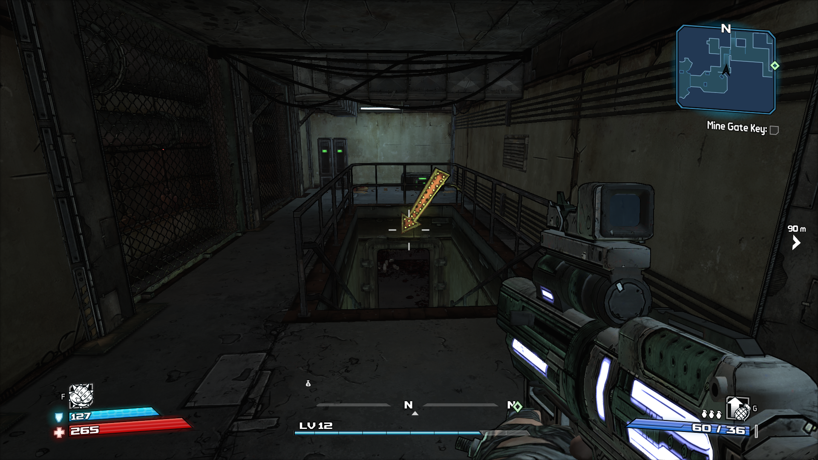
Can be bloody obvious…

Slide 6
Can be bloody obvious…
Go here dumbass…

Slide 7
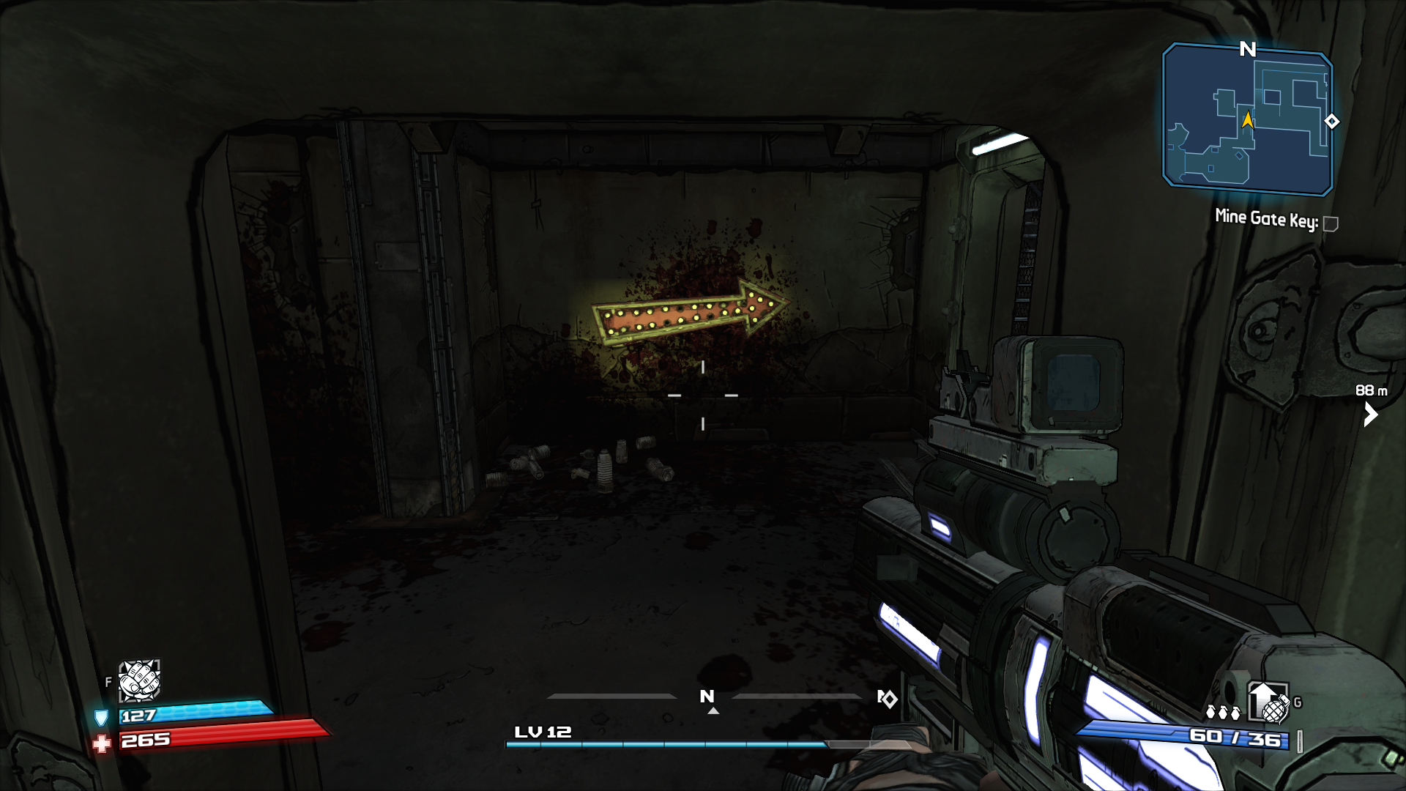
And communicate danger…

Slide 8
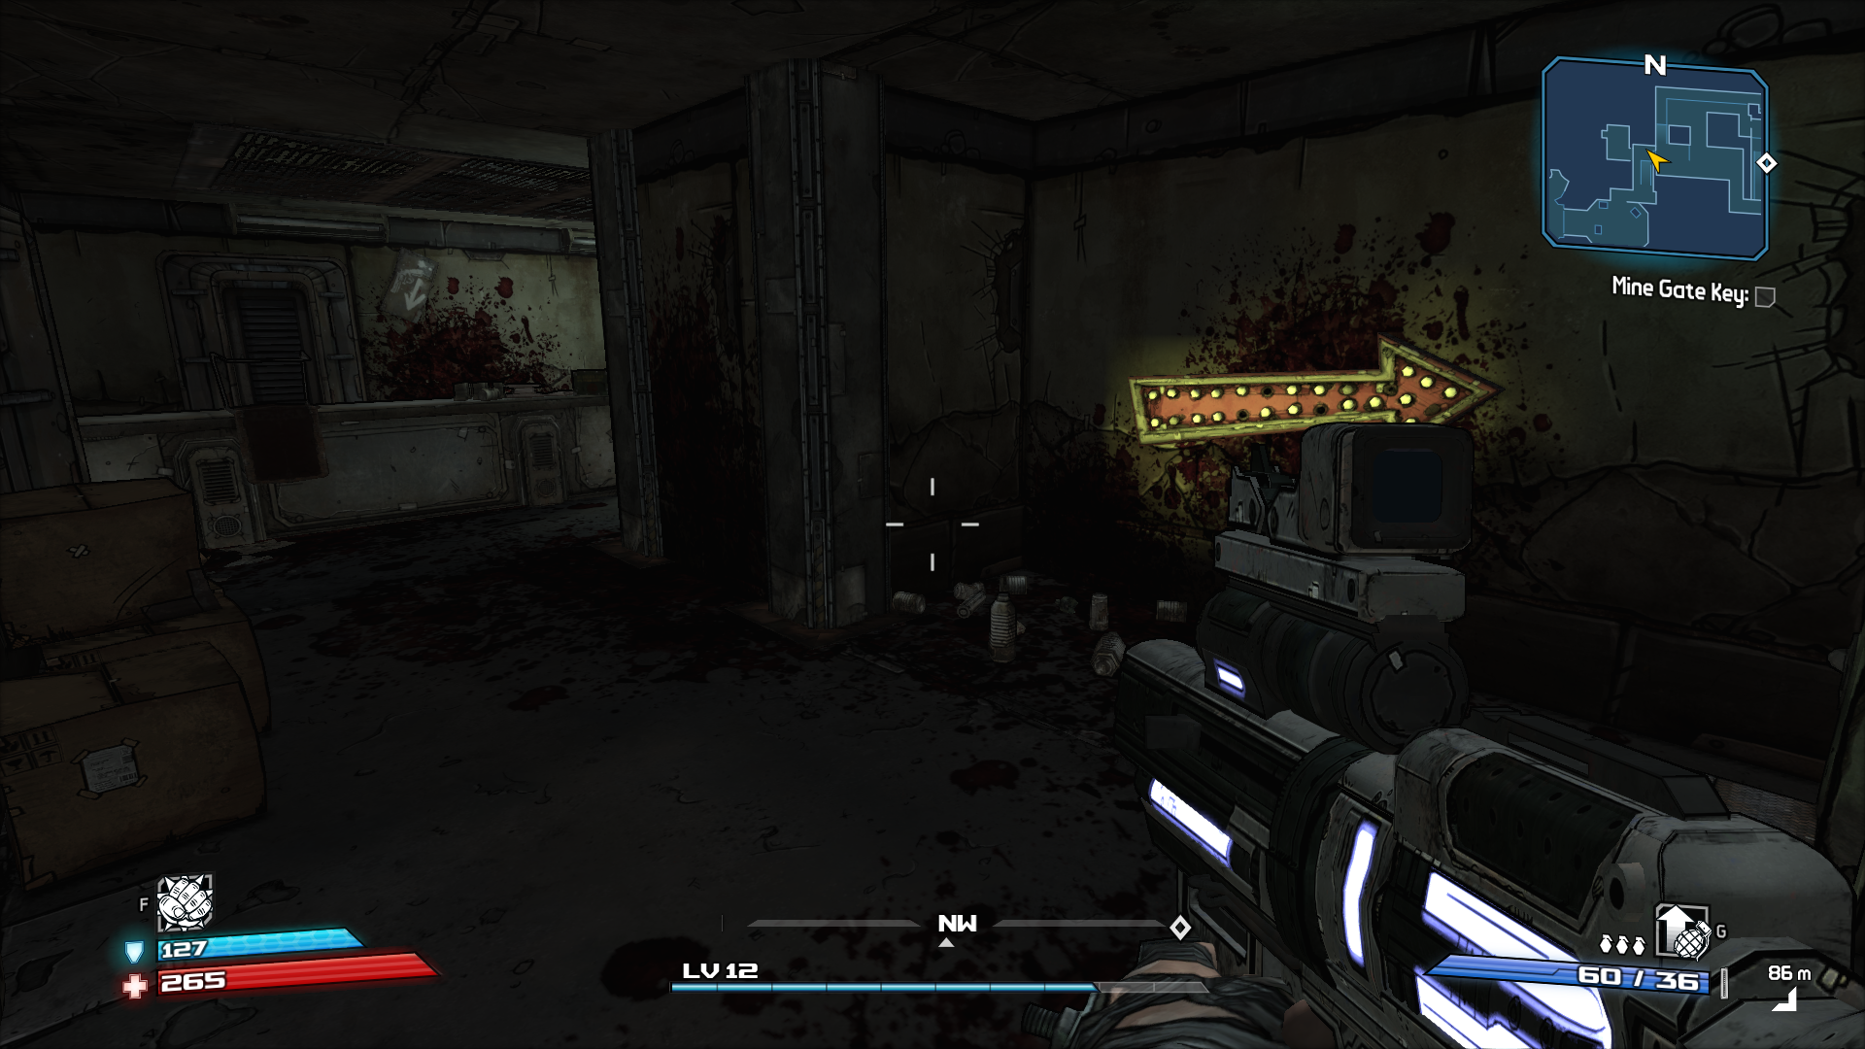
But they don’t always show you everything…

Slide 9
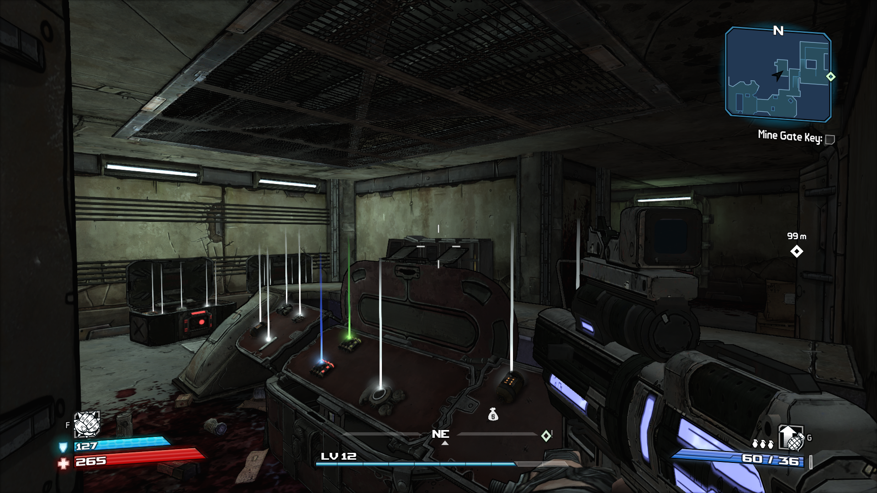
Discovery is important…

Slide 10
Subtly is often key.
You are trying to guide the player without explicitly telling them what to do!
If you are trying to tell them explicitly what to do, a tutorial prompt is more appropriate.

Slide 11
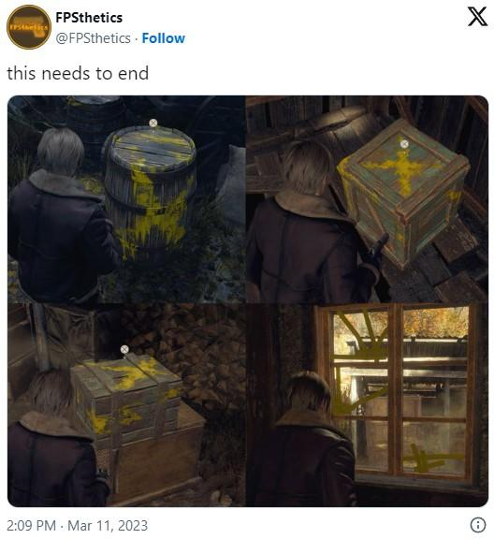
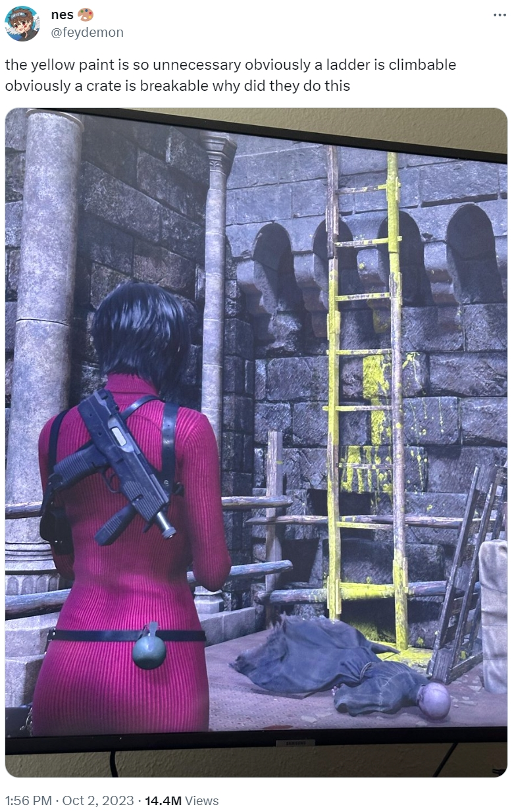
Overdoing it can cause controversy…

Slide 12
4 Types of UI
 | UI element is integrated into the fantasy of the game world | UI element is not integrated into the fantasy of the game world
UI element has a physical place in the game world | Diegetic | Spatial
UI element does not have a physical place in the game world | Meta | Non - Diegetic

Slide 13
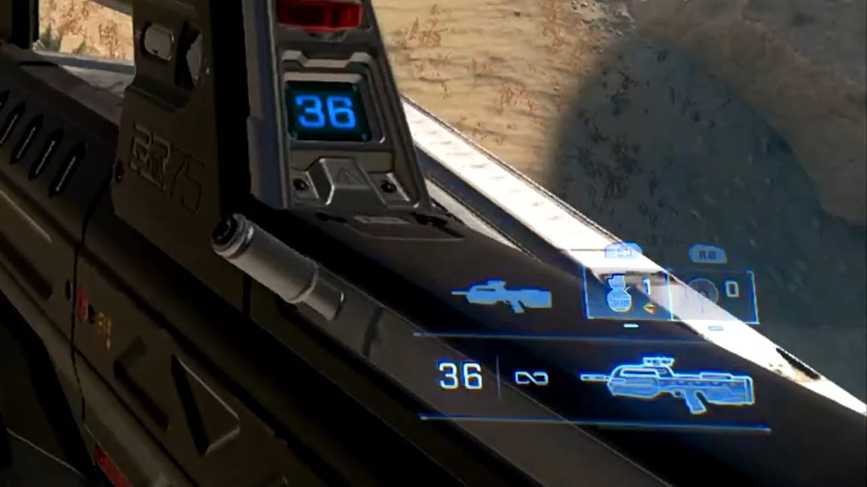

Slide 14
Diegetic

Slide 15
Diegetic
Non-Diegetic

Slide 16
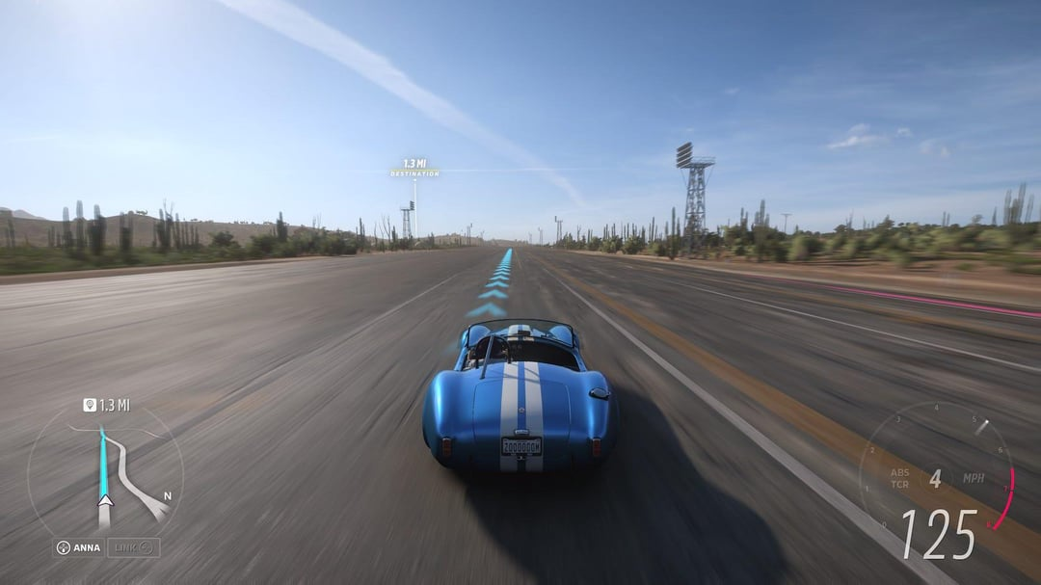

Slide 17
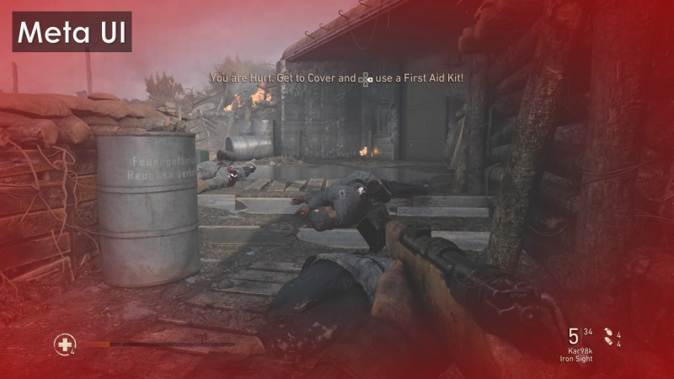

Slide 18
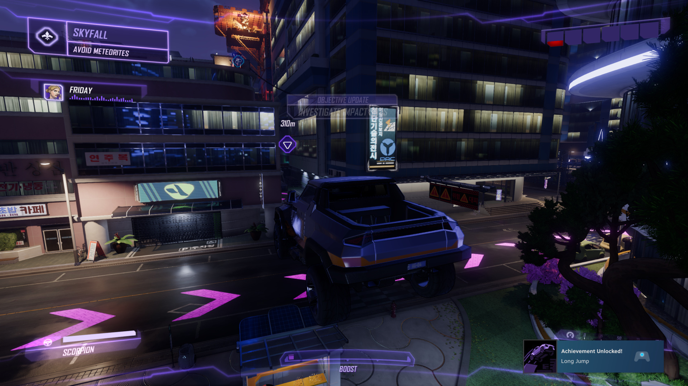

Slide 19
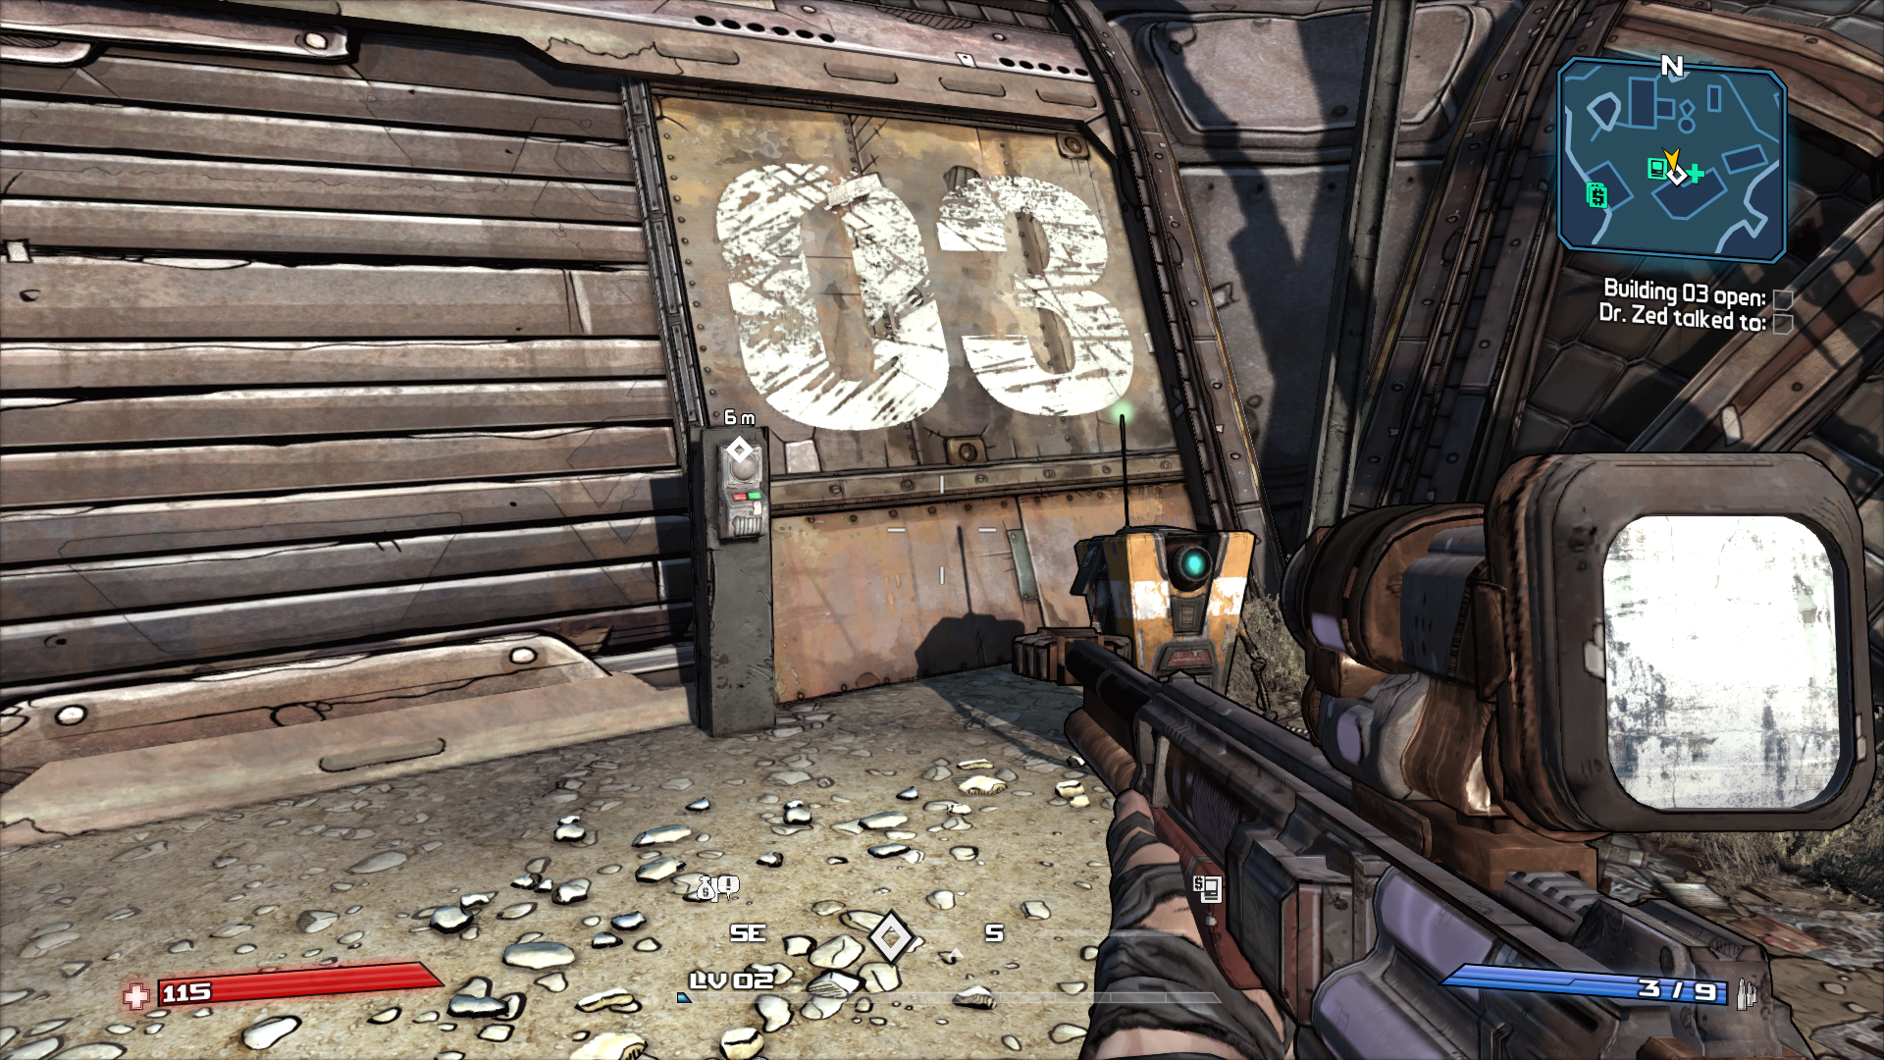
Waypoints

Slide 20
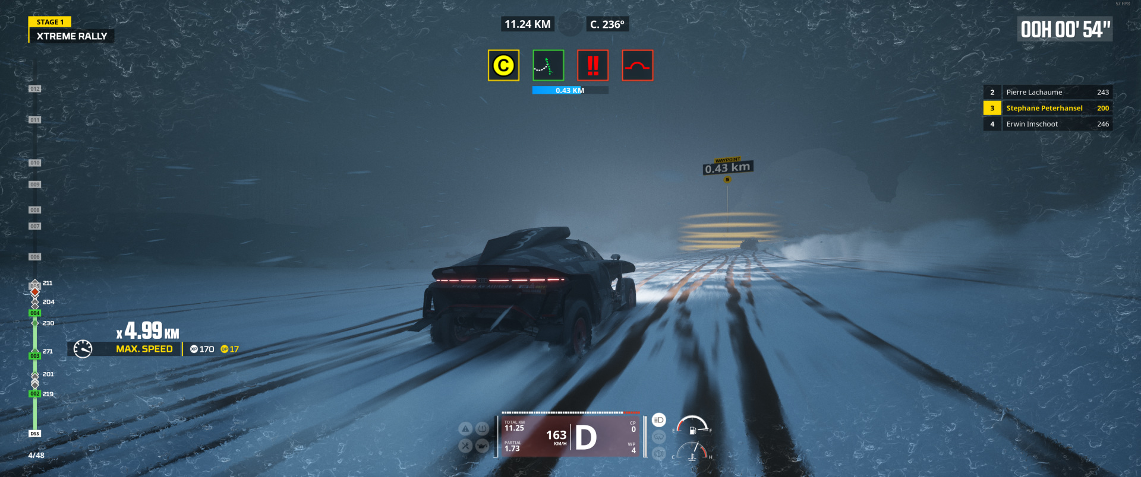

Slide 21
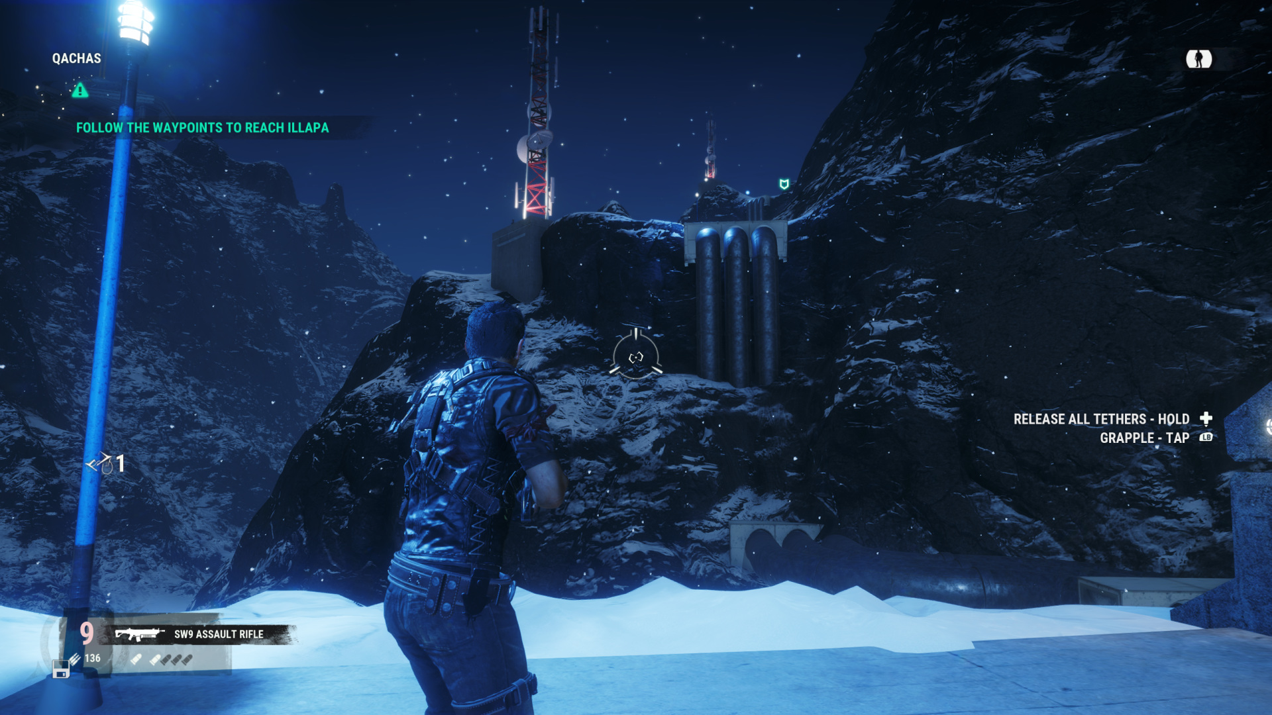

Slide 22
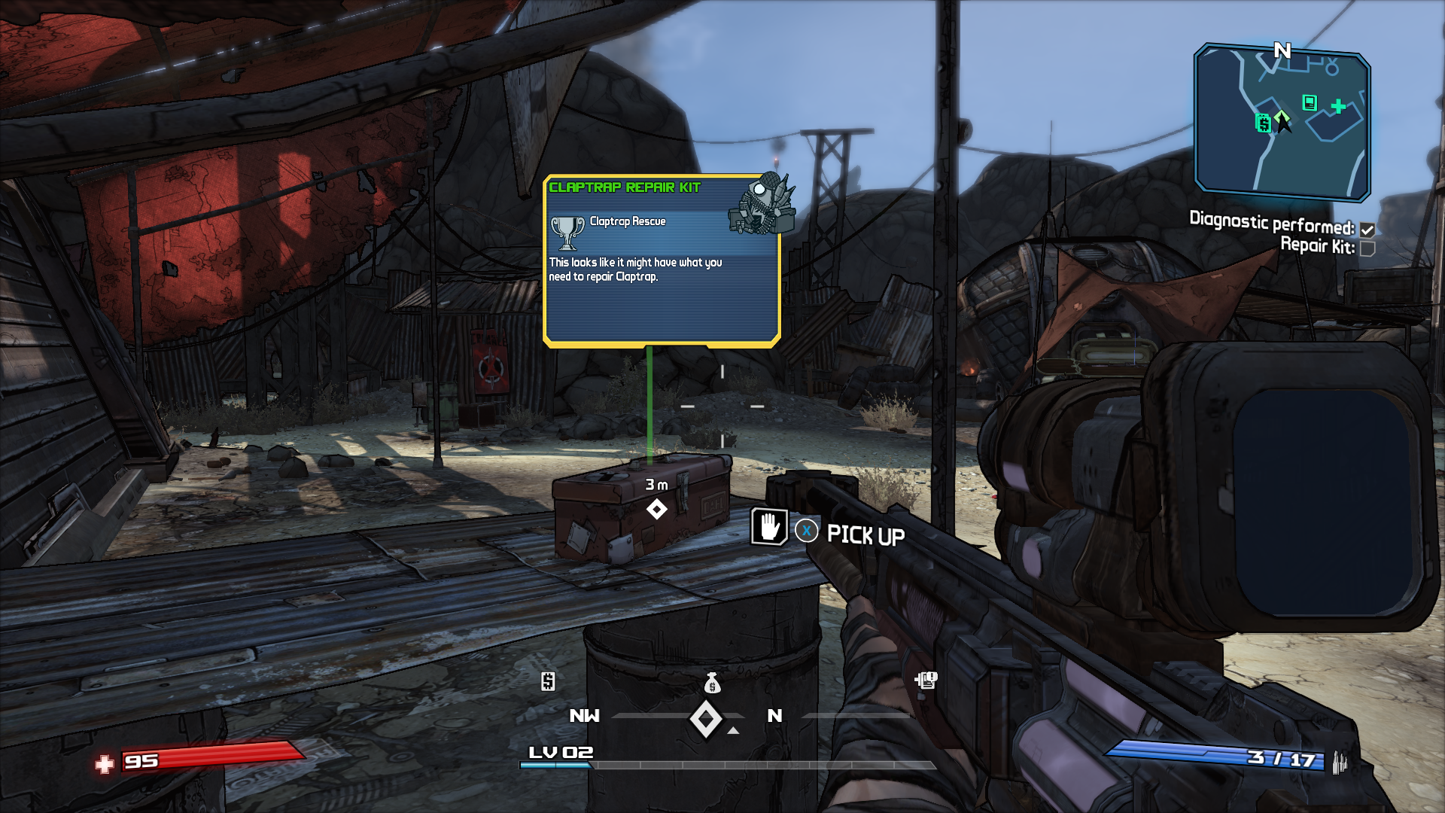
Point of Interest

Slide 23
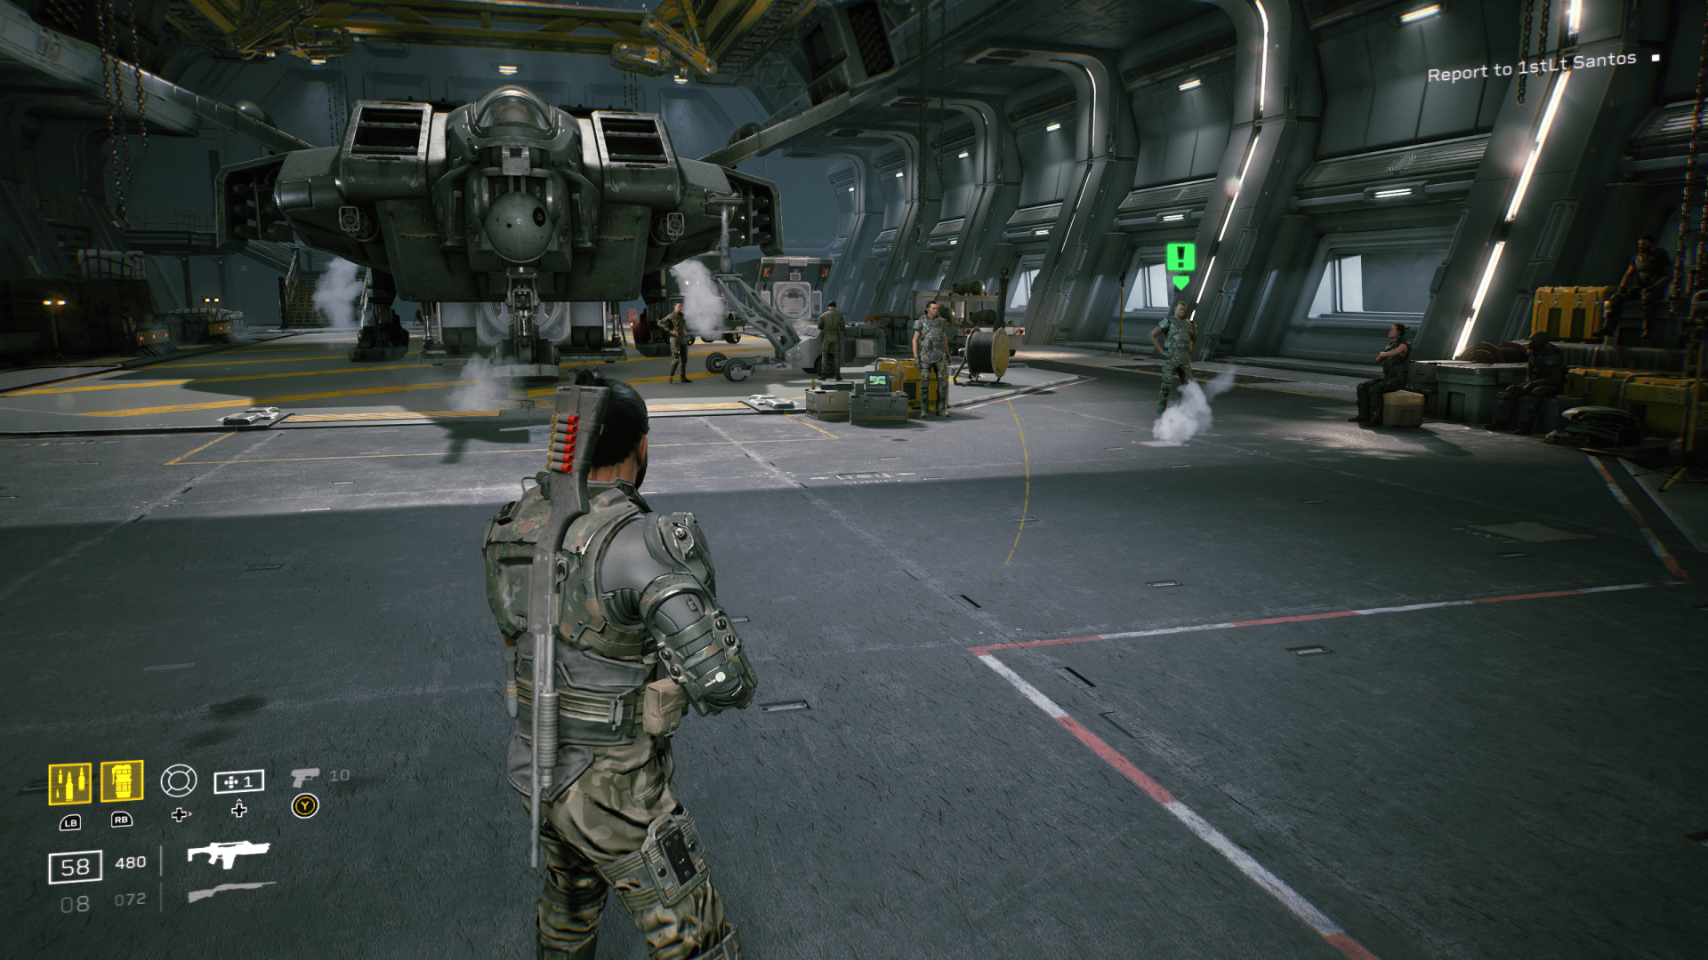

Slide 24
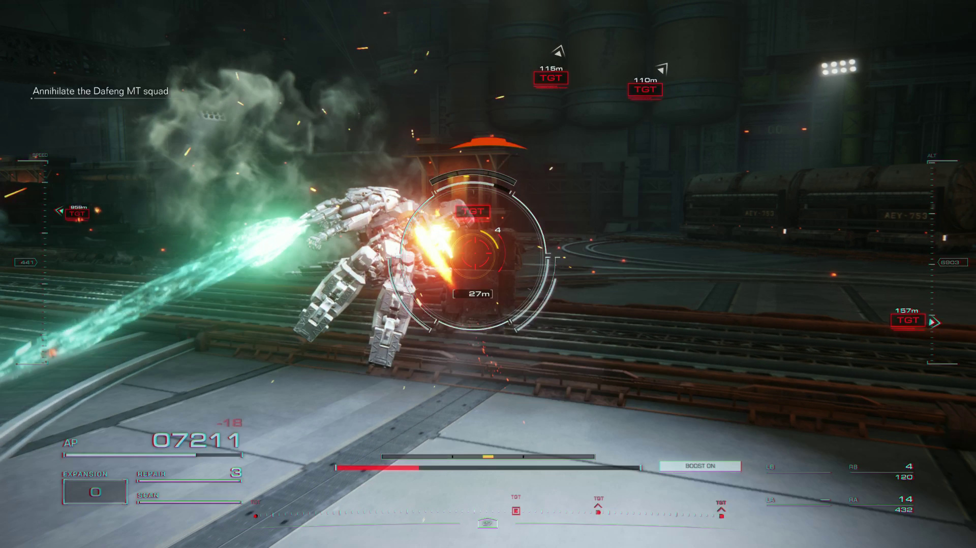

Slide 25
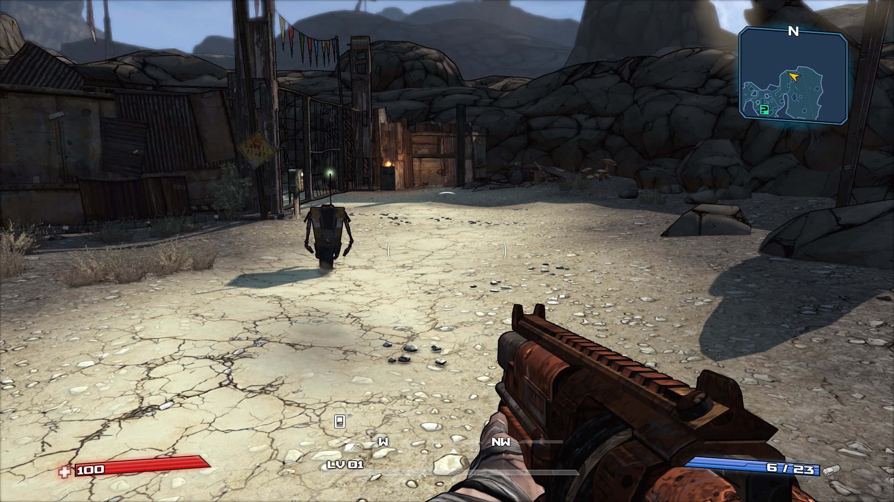
NPC guides

Slide 26

Hey Listen!

Slide 27
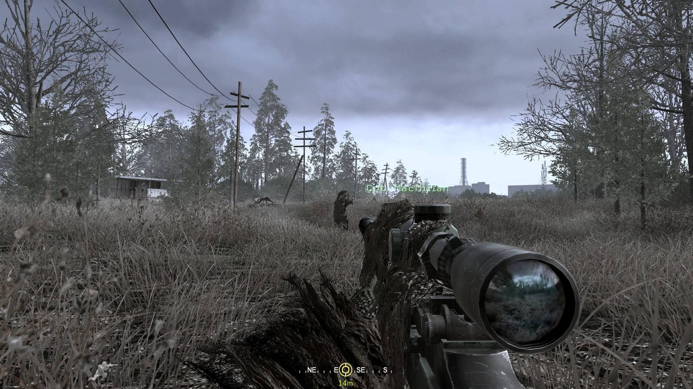
Not always a tutorial…

Slide 28
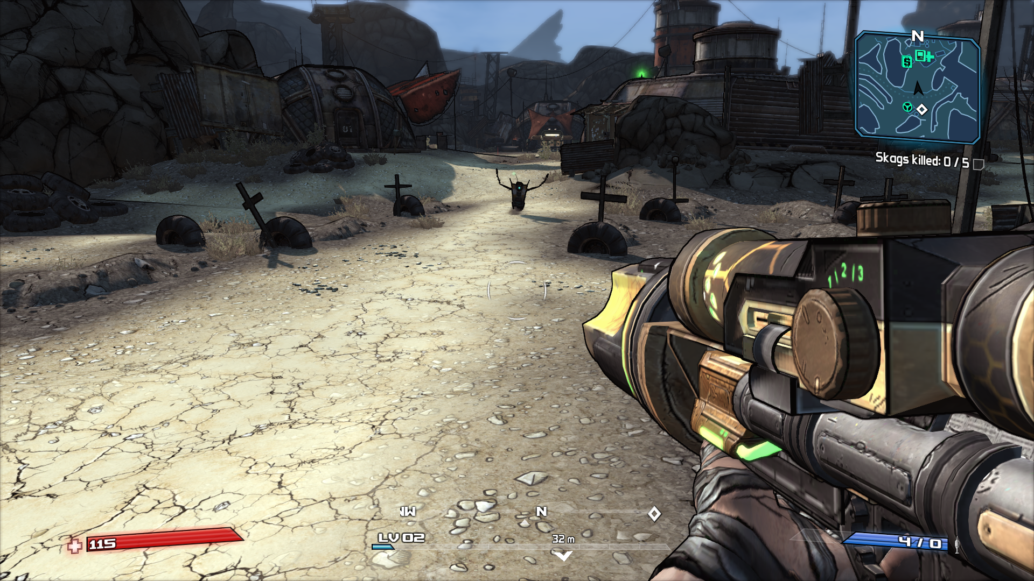
But they can be fussy…

Slide 29
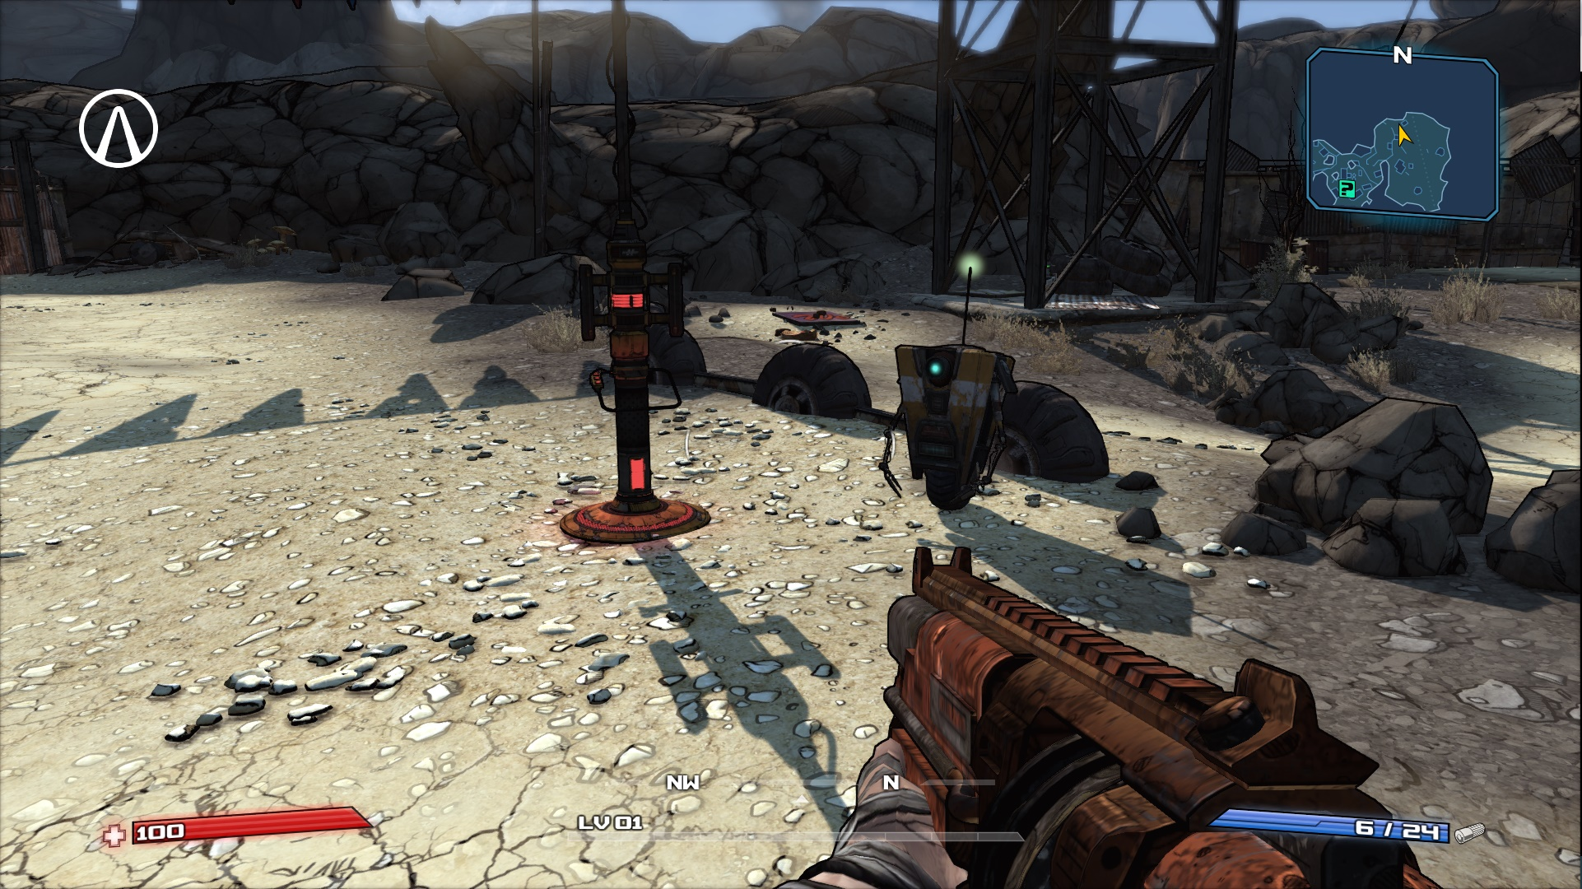
Off…

Slide 30
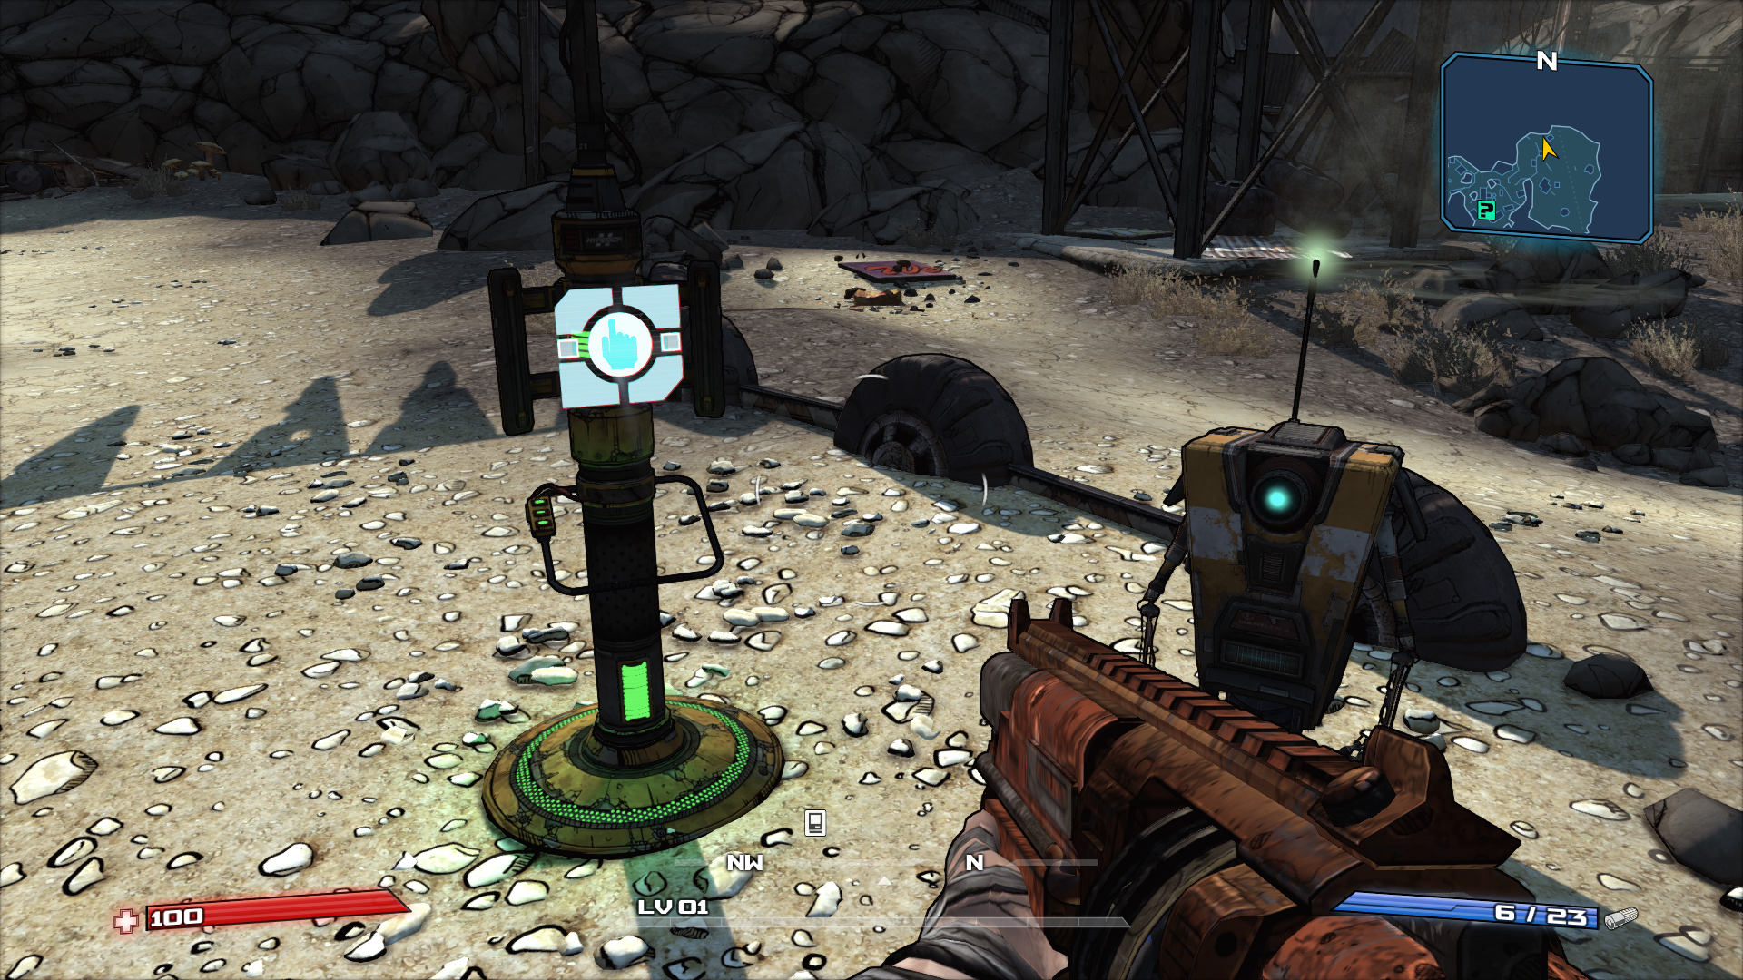
On!

Slide 31
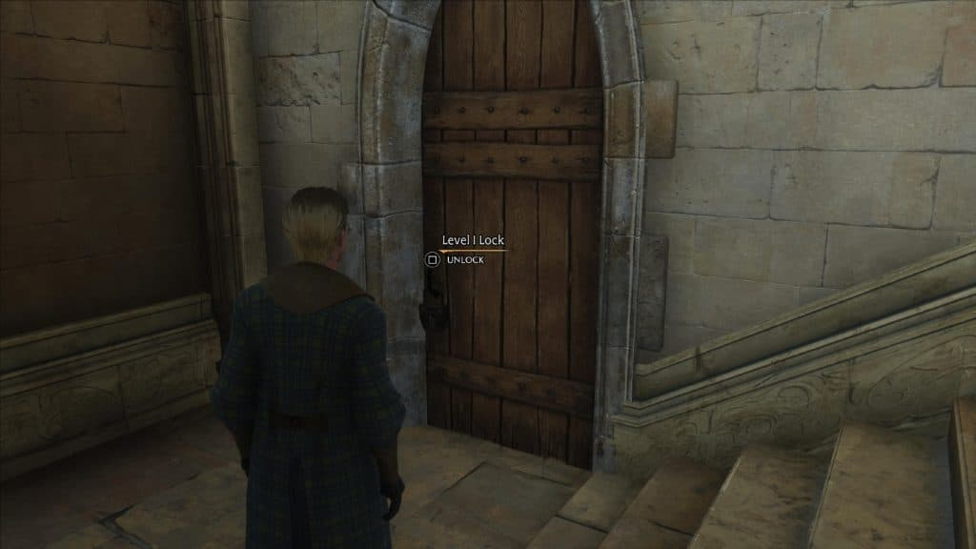
Locked?

Slide 32
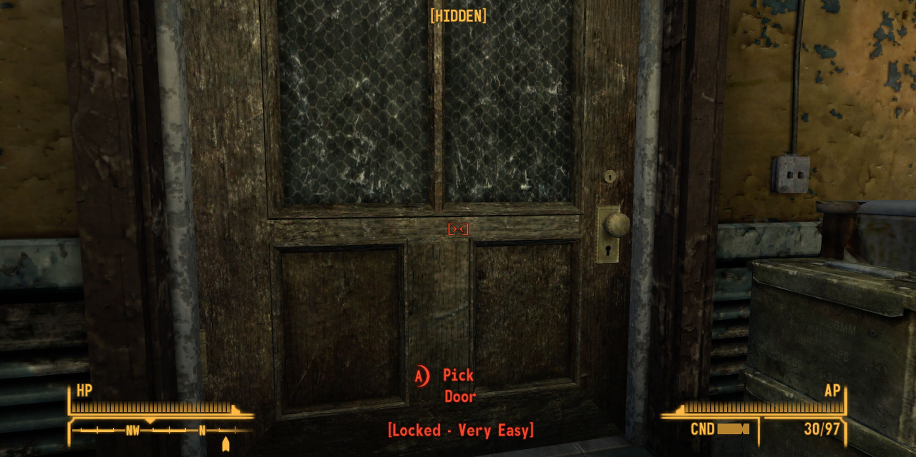

Slide 33
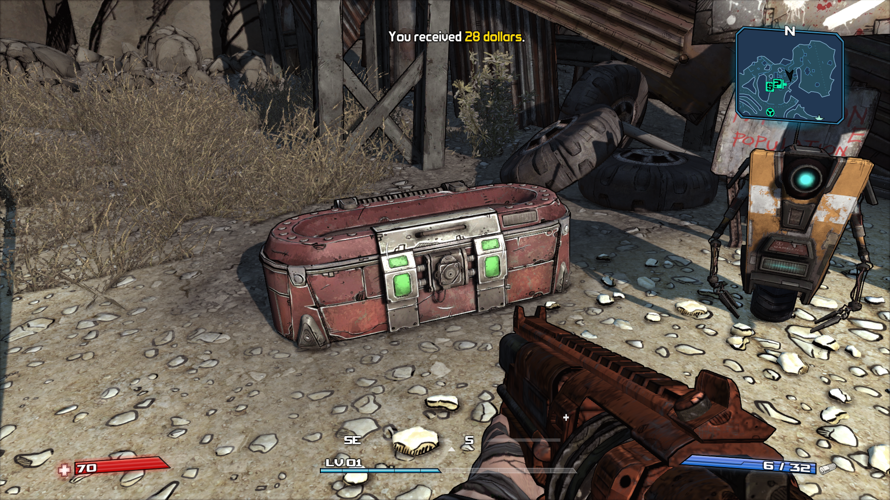
Lootable!

Slide 34
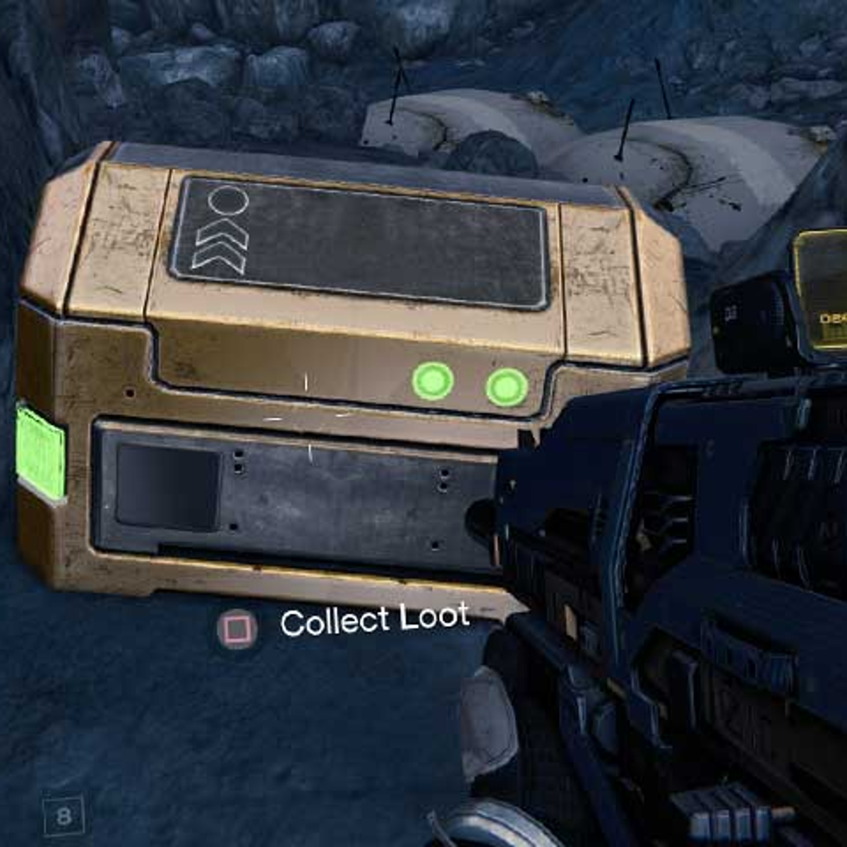

Slide 35
Not just visual…
Please open the box!

Slide 36
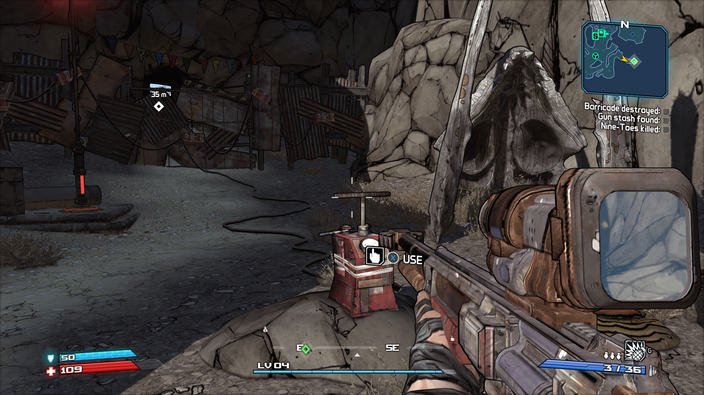
This controls that…

Slide 37
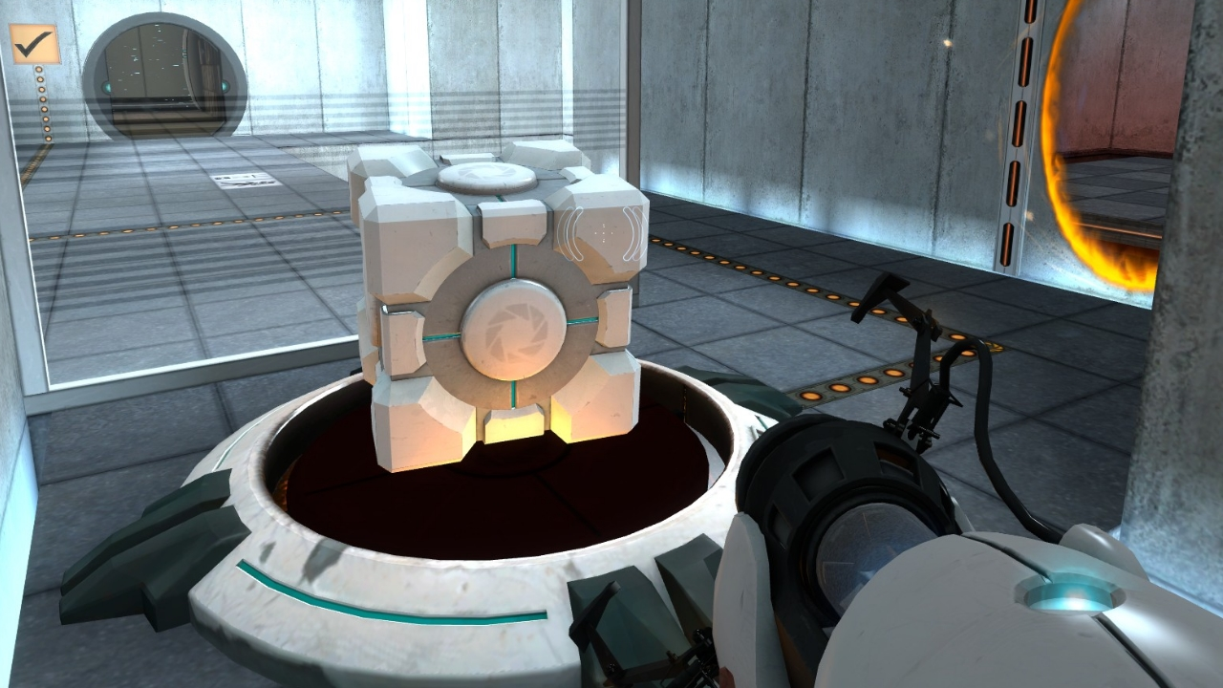

Slide 38
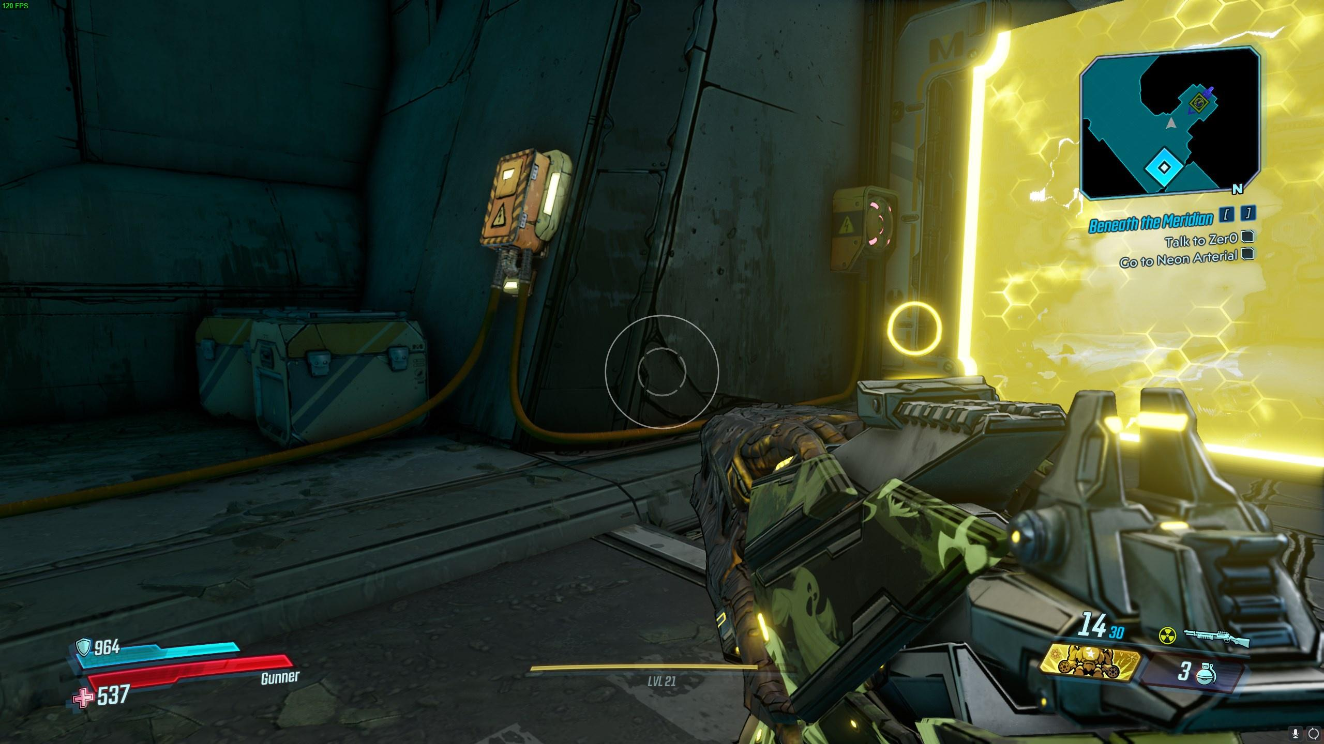

Slide 39
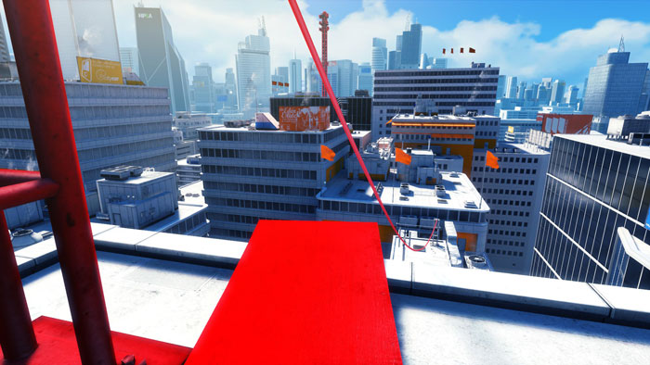
You can use this…

Slide 40
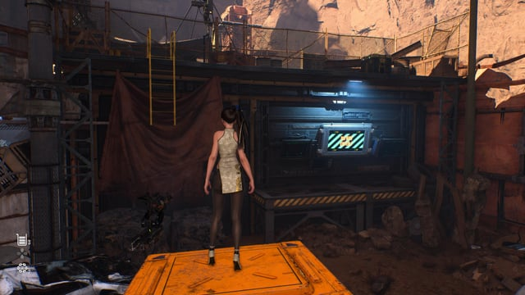

Slide 41
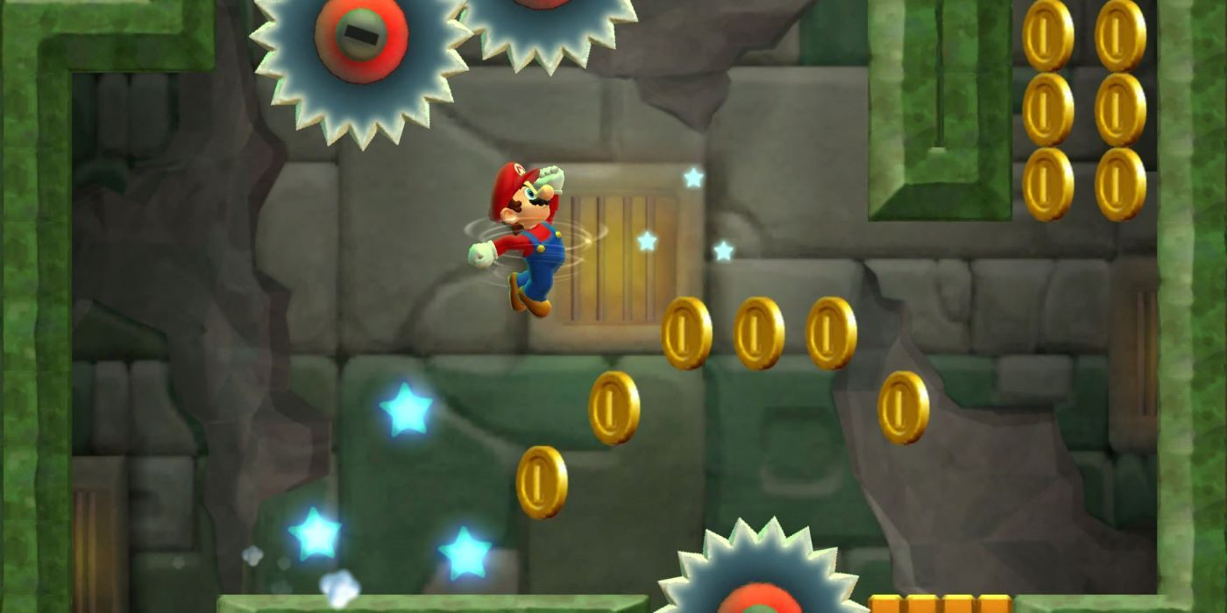
Breadcrumbs

Slide 42
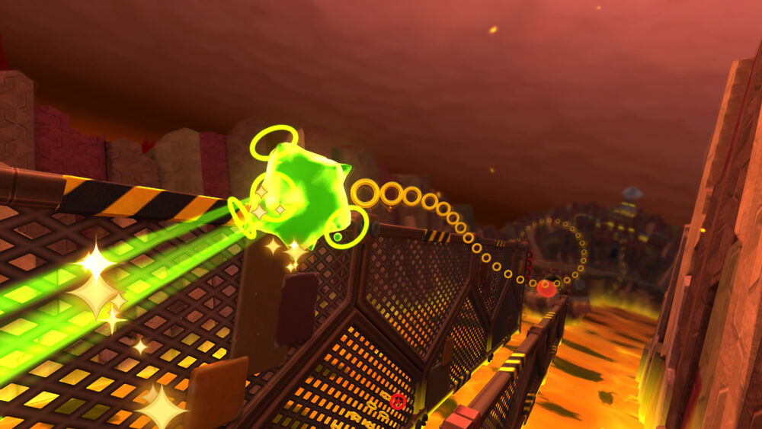

Slide 43
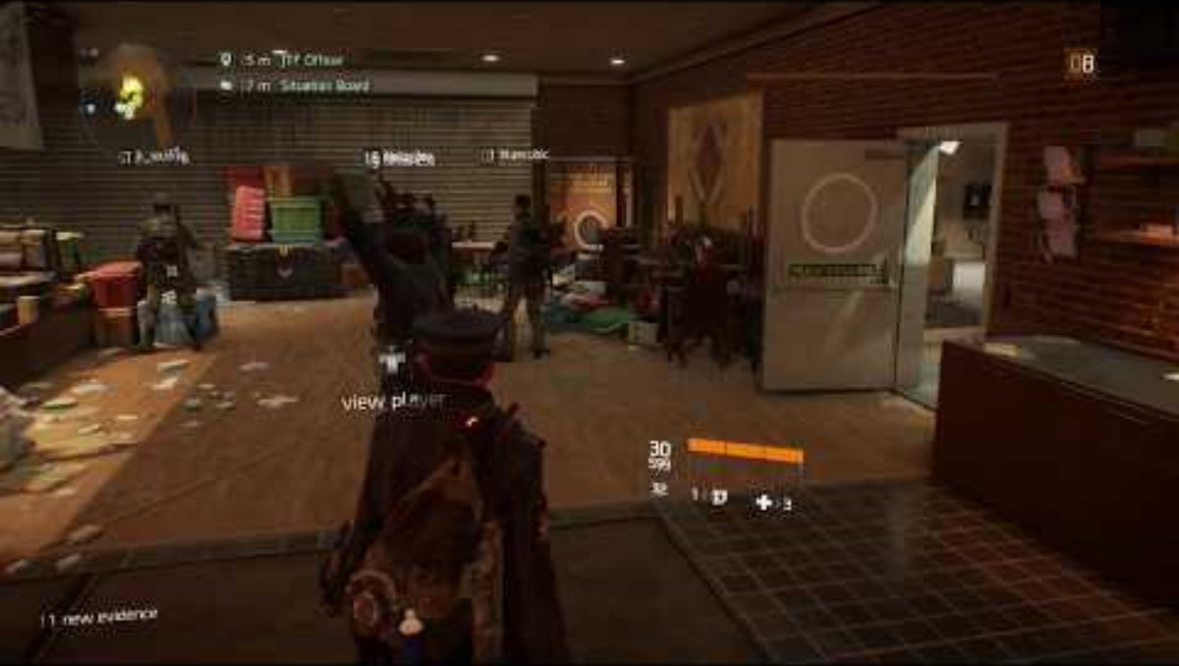

Slide 44
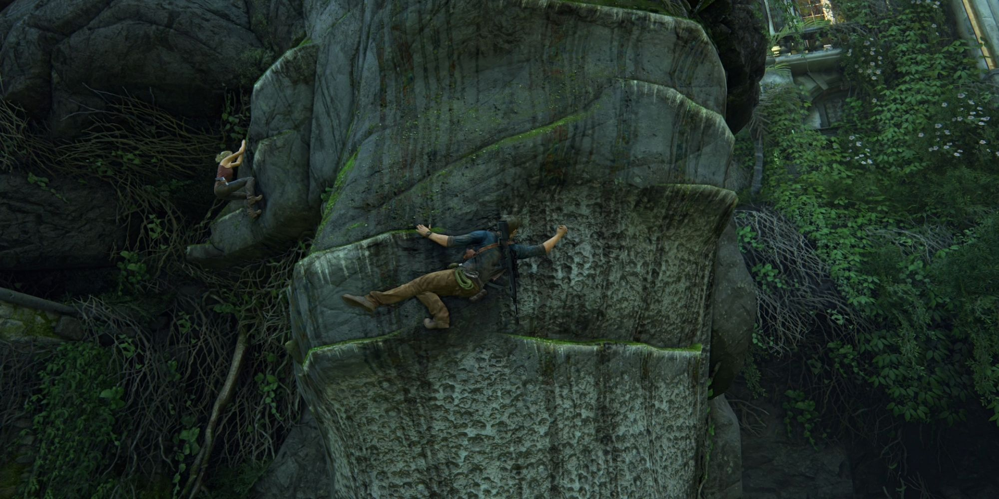
Colour

Slide 45
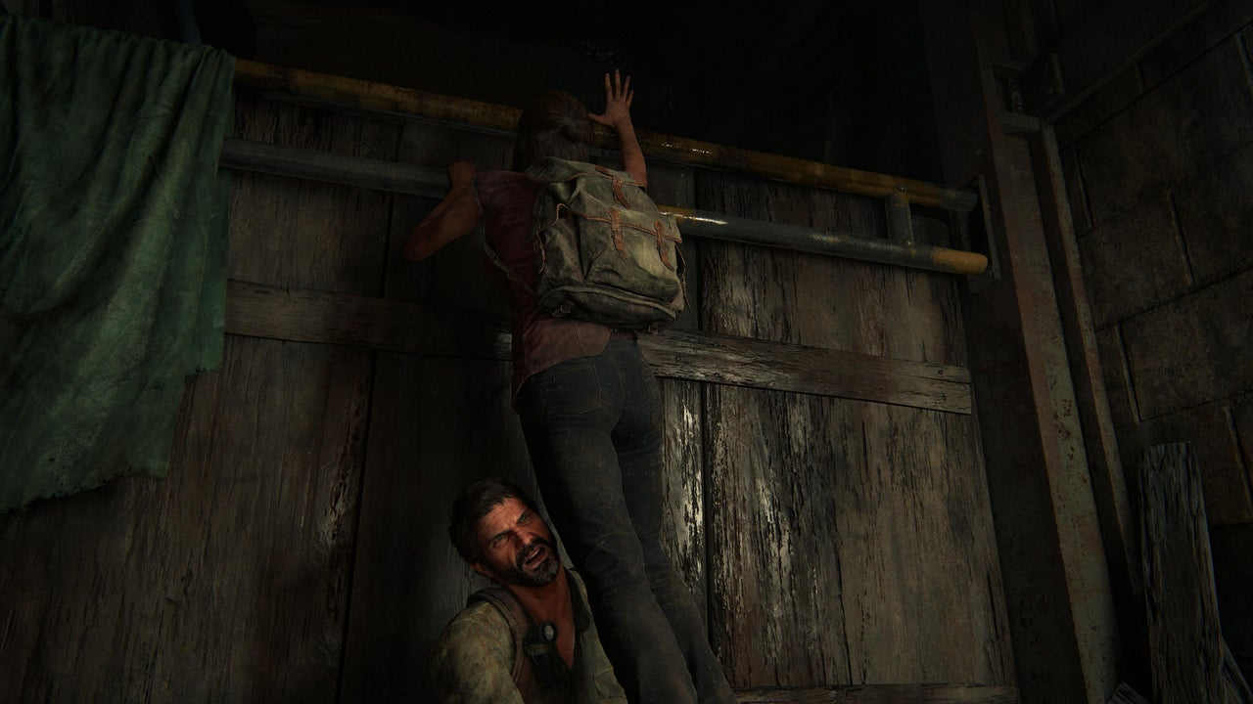

Slide 46
